Slide 1
Game Concept

Slide 2
Layout
01
02
03
intro
description
platform

Slide 3
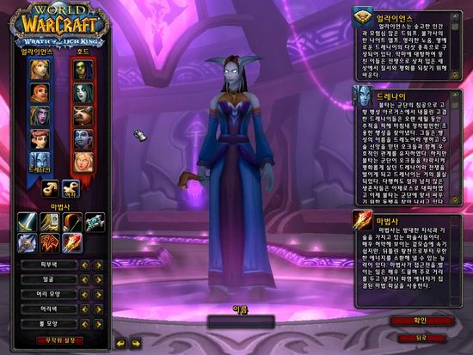
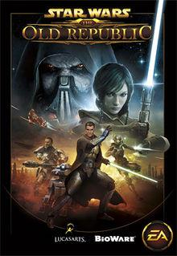
INTRO
01

Slide 4
DESCRIPTION
02
Role-Playing Game, RPG
Users can be…
victims of cyberbullying
attacker of cyberbullying
Teacher
position of a looker-on cyberbullying

Slide 5
DESCRIPTION
Massive Multiplayer Online Role Playing Game)
Massively multiplayer online role-playing games (MMORPGs) are a combination
of role-playing video games and massively multiplayer online games
in which a very large number of players interact with one another within a virtual world.

Slide 6
PLATFORM
03
Browser-based MMORPGs
+
Smartphone-based MMORPGs

